Slide 1
New sorter transfer teach procedure
S220 tcchuang0

Slide 2
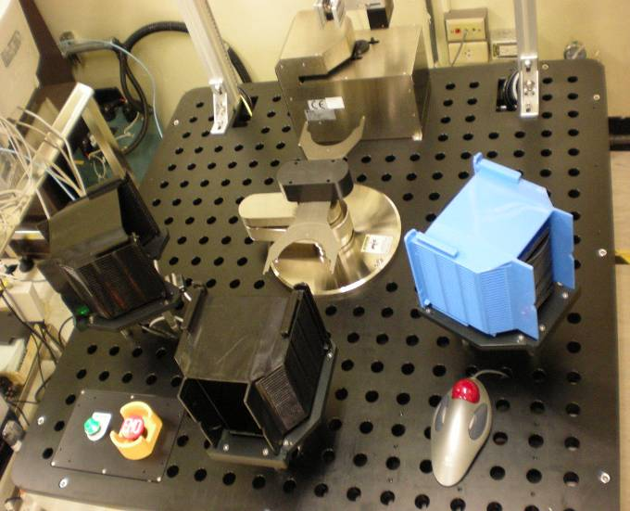
N3X機台各代號介紹
ALIGNER ASSY
｛有SCAN為Y
無SCAN為Z｝
ROBOT ASSY
無SCAN為0
有SCAN為1
有SCAN為 j
無SCAN為J
有SCAN為 m
無SCAN為 M
POWER ON&OFF
EMO
有SCAN為k
無SCAN為K

Slide 3
TEACH COMMANDS:
GET
GET [station], [slot] GET A,2
PUT
PUT [station], [slot] PUT B,2
HOM
All axes HOME
HOME A
Only robot
HOME a
Only Prealigner
MOVA
MOVA axis, position (, position, position) MOVe Absolute axis to position(s) specified MOVA T,1000
MOVA R,200
MOVR
MOVR axis, distance (, distance, distance) MOVe the axis Relative to the current position
MOVR T,1000
MOVR R,200

Slide 4
RCP
RCP axis (, variable, variable, variable)
Read Current Position
RCP A--ROBOT
RCP a--- PRE ALIGNER
RCS
RCS station (, variable, variable, variable)
Read Coordinate Setting
RCS A
RCS B
RCS C
RAD
RAD axis (,variable, variable, variable)
Read current Acceleration (and Deceleration)
Use RAD to read the current acceleration and deceleration of the specified axis
RAD A—ROBOT
RDL
RDL axis (, variable, variable, variable)
Read current DeceLeration
RDL reads the deceleration for the specified axis. To store the acceleration value, RDL A--ROBOT…

Slide 5
RETH
RETH (station)
RETract Radial to Home
Use RETH to retract the Radial axis to customized home position at current speed and
acceleration.
RFAA
RFAA
Read Flat Angle Alignment
Use RFAA to read the final flat or notch angle position, which has been set by SFAA. For FAA,
orientation is measured to 0.01º. Zero degree is along the radial R
ROF
ROF station (, variable)
Read OFfset value
Use ROF to read the offset set by SOF for the specified station. Offset is the station
property that sets the limit on vertical movement for picking and placing a wafer. To
store the offset value, specify a numeric variable.
RSP
RSP axis (, variable, variable, variable)
Read current SPeed for specified axis
RSP reads the speed of the specified axis (axes) from Galil and returns the value(s).
To store the speed, specify a numeric variable(s). Use RSP in macros that need to temporarily
change the speed for a special operation.

Slide 6
RWL
RWL (variable)
Read Wafer Loading position
RWL reads the pre-aligner wafer loading position set by the SWL command and stored in the
Wafer Parameter File. The pins must be down to load a wafer. The z axis is moved to this
pins-down position before loading a wafer.
RWS
RWS (variable)
Read Set Wafer S ize
RWS reads the wafer size set by the SWS command and returns the number in either inches
or millimeters, depending on the original input. To store the wafer size,
RWU
RWU (variable)
Read Wafer Unloading position
RWU reads the pre-aligner unloading (up) position set by the SWU command and stored in the
Wafer Parameter File. For a three-axis pre-aligner, the pins must be up
(in the unloading position) before the pins can move the wafer in the r direction.
SAD
SAD axis, acceleration (, acceleration, acceleration)
Set operational Acceleration (and Deceleration)
Use SAD to set the acceleration for one axis, all robot axes (A), or all pre-aligner axes (a).
This value is used when moving the robot and pre-aligner axes. To save the SSP value to the
RAM local copy or NVSRAM, use the SAV command. To recover the speed set by SSP and the
acceleration set by SAD, use the RSA command.

Slide 7
SAV
SAV
SAVe current coordinates and parameters to NVSRAM
Use SAV to save current coordinates and parameters to NVSRAM while the robot is idle and
no macros are running. Although you can execute SAV while a macro is executing, problems are
created if the macro changes parameter values while you are saving other values. SAV copies the
current RAM values to NVSRAM.
SDL
SDL axis, deceleration (, deceleration, deceleration)
Set DeceLeration
Use SDL to set one axis or all robot axes (A) or all pre-aligners axes (a).
To save the SDL value to the RAM local copy and NVSRAM, use the SAV command.
SFAA
SFAA angle
Set Flat Angle Alignment
SFAA sets the final flat or notch angle position. The angle is measured to 0.01º and zero degree
is along the radial axis movement across from the outer sensor.
The default value for the angle is 0.
SOF
SOF station, Z-offset
Set OFfset value
Use SOF to set the offset value to be used by various move commands. Offset is the station
property that sets the limit on vertical movement for picking and placing a wafer.

Slide 8
SPC
SPC station, T, R, Z
Set Position of the specified S tation
Use SPC to set the T, R, Z coordinates of the station position. A valid station name is any letter
from A to Z or a to z.
When naming a station, consider using a naming convention that suggests the use or purpose
of the station. For example, if you have two types of stations, use upper case letters for the first
type and lower case letters for the second case.
For reading the current station coordinates, see RCS.
SSP
SSP axis, speed (, speed, speed) Set operational speed
Use SSP to set the operational (not home) speed for the specified axis. To save the SSP value
to the RAM local copy or NVSRAM, use the SAV command. To recover the speed set by SSP
and the acceleration set by SAD, use the RSA command.
SST
SST station, stroke
Set STroke value
SST sets the stroke value for the specified station. Stroke is the station property that limits the
vertical travel to the distance required to pick and place a wafer. Stroke includes the distance
above and below the wafer, which is usually twice the offset distance. The STROK command
uses the value set by SST to move vertically.To read the current stroke value, use RST.

Slide 9
SVOF
SVOF (axis)
Turn SerVo motor OFf
Use SVOF to turn off the servo motor for the specified axis or axes. For an
integrated system, you can specify A for all robot axes (T, R, Z) or a for all prealigner
axes (t, r, z). If you do not specify the axis parameter, the servo motors for all
axes in the system are turned off.
SVON
SVON (axis)
Turn SerVo motor ON
Use SVON to turn on the servo motor for the specified axis. For an integrated system, you can
specify A for all robot axes (T, R, Z) or a for all pre-aligner axes (t, r, z). If you do not specify the
axis parameter, the servo motors for all axes in the system are turned on.
SWL
SWL position
Set Wafer Loading position
SWL sets the wafer loading position, which is stored in the Wafer Parameter File. Enter the
position as a number or as a numeric variable.
SWS
SWS size
Set Wafer S ize
SWS sets the wafer size. Enter the size in either inches or millimeters.

Slide 10
SWU
SWU position
Set Wafer Unloading position
SWU sets the wafer unloading position, the lift up position, which is stored in the
Wafer Parameter File. Enter the position as a number or as a numeric variable.

Slide 11

1.至電腦桌面點取NADASorter
點取滑鼠右鍵2下即可進入

Slide 12
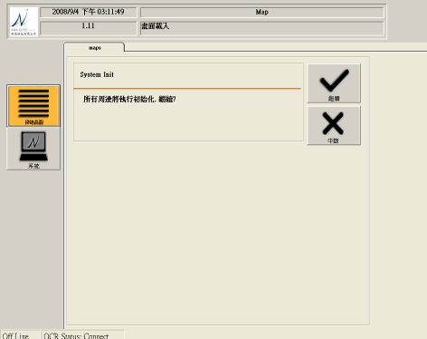
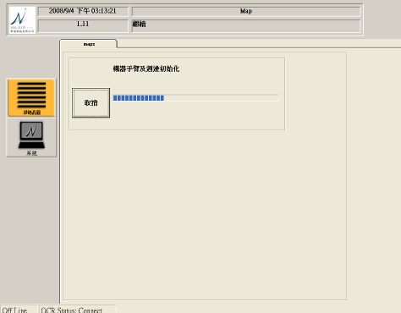
2.點選之後,會出現如下圖所示.
點選繼續之後,機台會自動做INITIAL ALL HOME.
點選滑鼠右鍵
INITIAL畫面

Slide 13
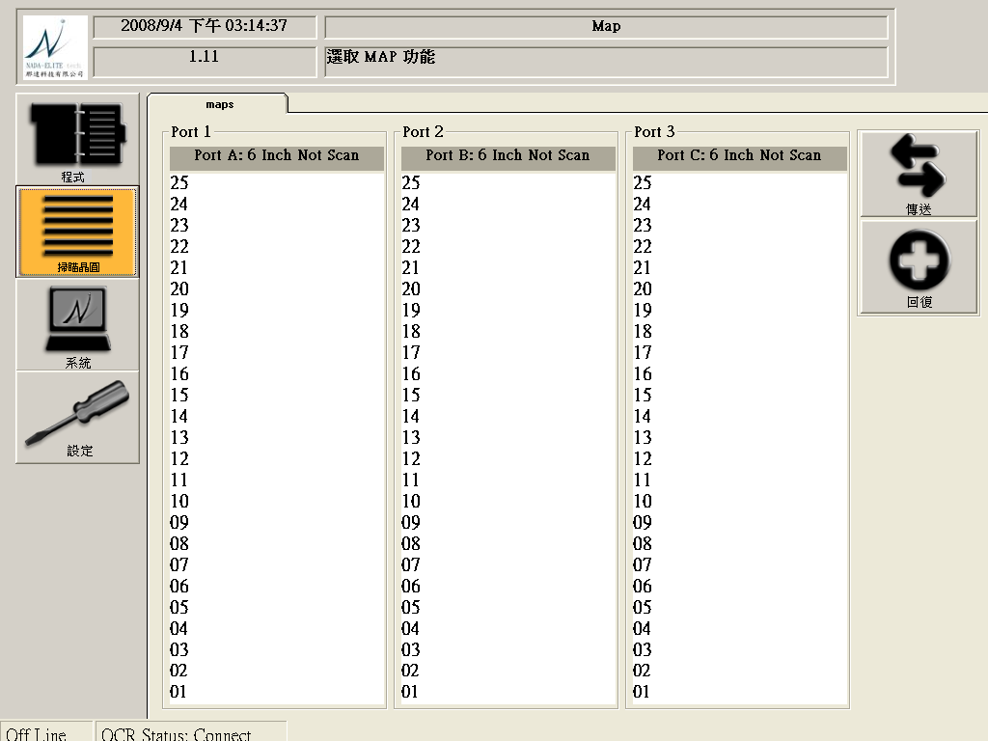
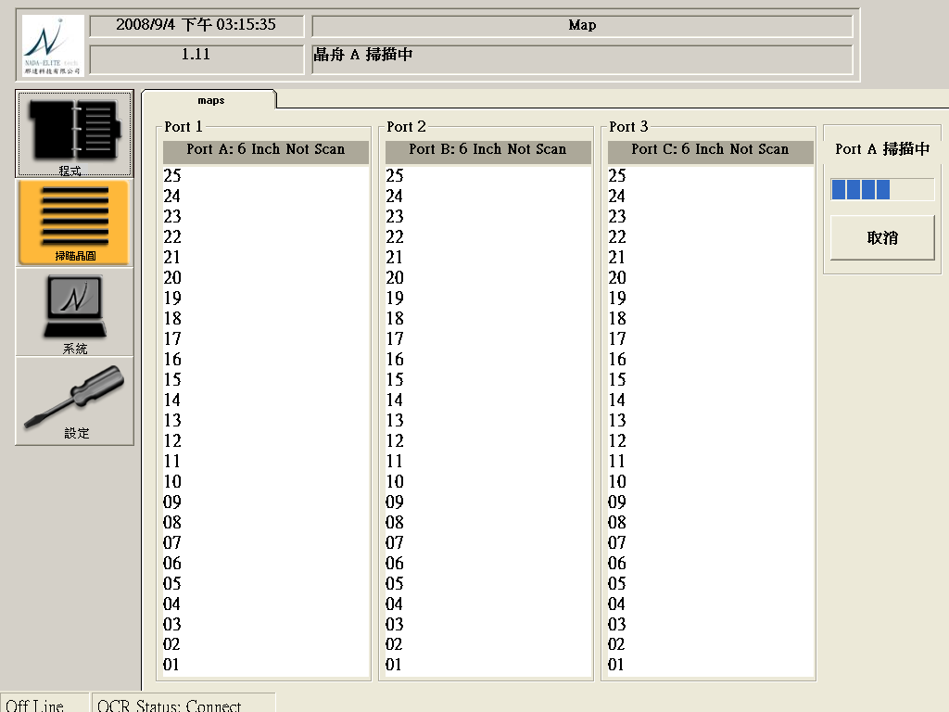
3.INITIAL ALL HOME之後,出現以下畫面,按下右上方傳送的方塊
之後,機台會自動SCAN MAPPING.
點選滑鼠右鍵
SCAN畫面

Slide 14
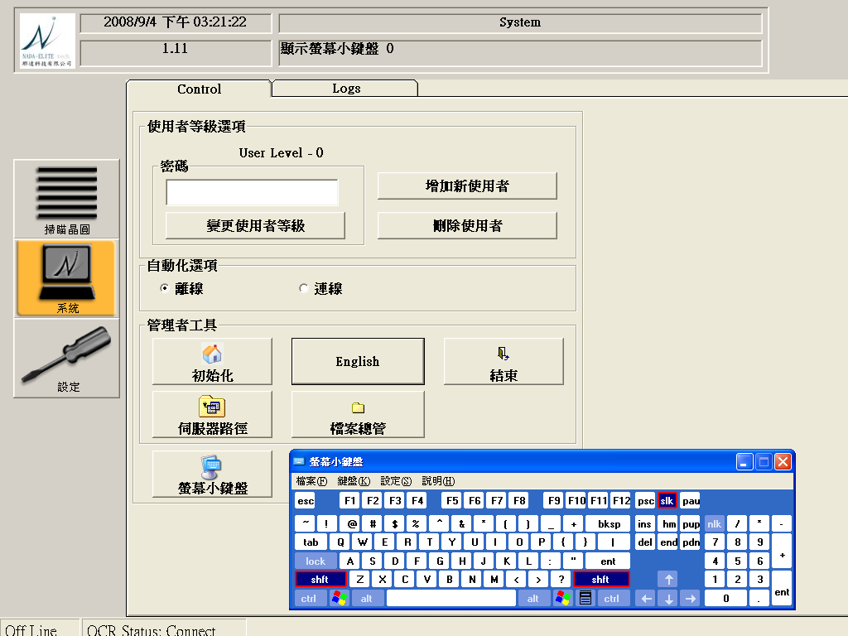
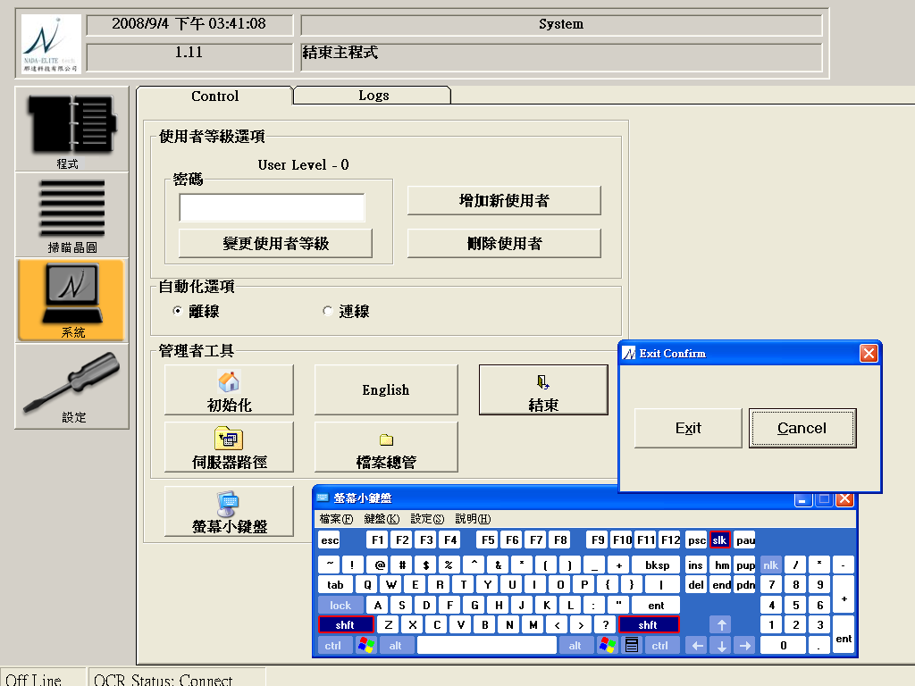
4.至系統裡 點選螢幕小鍵盤,會出現小鍵盤,在點選密碼
輸入密碼:a0,按下結束方塊,點選Exit,自動會跳到window畫面
輸入密碼:a0

Slide 15
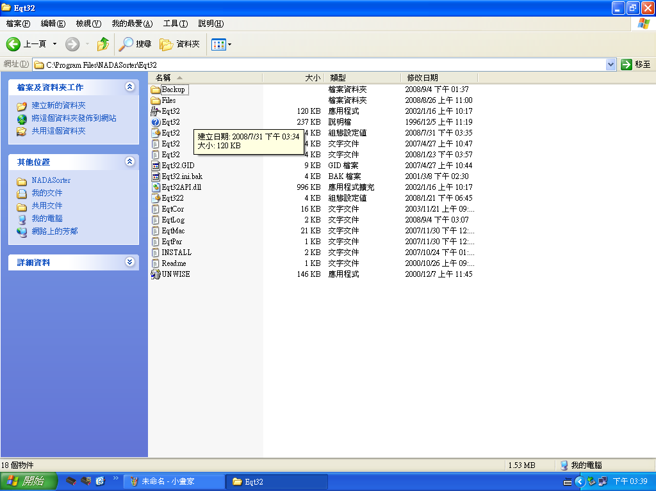
5.到”開始”裏面點選C槽的PROGAME FILE資料夾
→點選NADASORTER資料夾→點選Eqt32執行檔

Slide 16
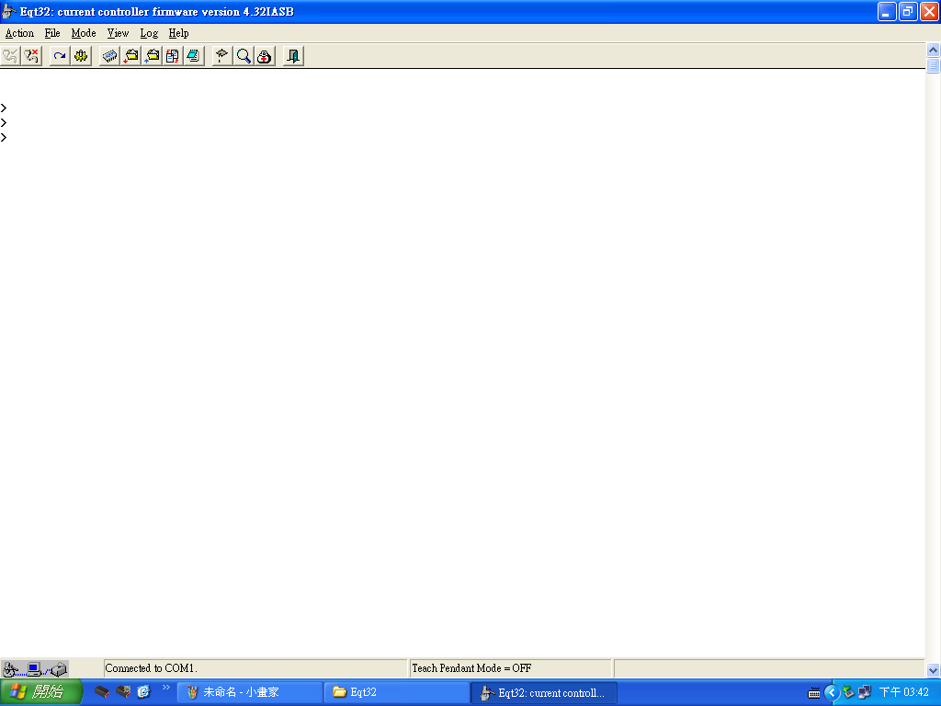
6.出現Eqt32此畫面之後,即可開始對機台作傳送校正.
下command處
注意:COMMAND需大寫才能執行

Slide 17
7. WAT N3X SORTER TEACH校正,需校正12次
分為4類:ALIGNER
STAGE FOR ROBOT
SCAN MAPPING
OCR SCAN刻號辨識
1.(STAGE*3 *ROBOT*2) 6次
(STAGE J,STAGE j,stage K,stage k,stage M,STAGE m)
2. ALIGNER 2次 (Y,Z)
3. SCAN 3次 (J,K,M)
4. OCR辨識
校正流程:
ALIGNER 校正
→TEACH STAGE POSITION
→SCAN MAPPING
→OCR校正

Slide 18
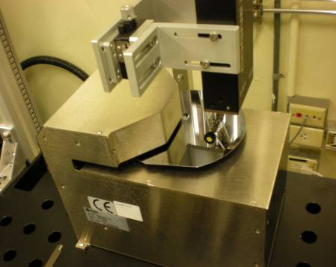
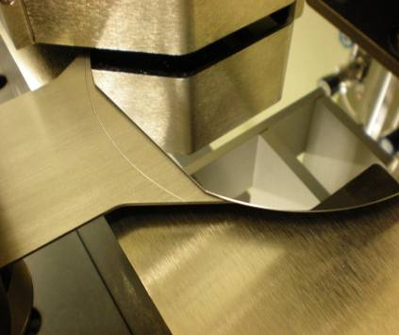
ALIGNER校正:
1.先放一片WAFER於ALIGNER
COMMAND:ALIGN(此時WAFER會自己旋轉做INITIAL).
2.下COMMAND:MTPS Z(此時T軸與Z軸會轉到ALIGNER)
3.COMMAD:SVOF R(此時可以移動R軸至ALIGNER)
NOTE:1.WAFER EDGE需與BLADE弧線切齊
2.BLADE Z軸與WAFER需有一點間隙才可.
若N.G,則利用ONE MOTION微調(T,R,Z)三軸的參數.
WAFER EDGE需與BLADE
弧線切齊

Slide 19
4.調整OK後,需讀出現在ROBOT T,R,Z POSITION.
COMMAND:RCP(CHECK ROBOT現在的POSITION)
5.儲存ROBOT的POSITION
COMMAND:SPC Z,T,R,Z(儲存ROBOT現在的POSITION)
6.CHECK POSITION是否儲存成功
COMMAND:RCS Z
7.SAVE至RS232 CPU裡.
COMMAND:SAV(儲存至CPU裡)
8.將SERVO T,R,Z CONTROLLER ON起來.
COMMAND:SVON
9.將R軸拉來HOME點
COMMAND:RETH(R軸回HOME點)
10.CHECK SERVO T,R,Z SPEED
COMMAND:RSP(讀取T,R,Z,三軸現在的速度)
11.將R軸減速 CHECK WAFER與BLADE Z軸的高度
COMMAND:SSP R,200
12.在RSP一次,CHECK R軸速度是否有更改成功.
13.將 SEVRO T,R,Z SPEED SAVE至CPU.
COMMAND:SAV(儲存至CPU)
14.DO INITIAL ALL HOME
COMMAND:HOM(DO ROBOT AND ALIGNER HOME).
15.TEST放WAFER至ALIGNER是否在規格之內.(BLADE切齊 WAFER EDGE)
COMMAND:PUT Z,1
16.TEST抓WAFER至ALIGNER是否在規格之內.(BLADE切齊 WAFER EDGE)
COMMAND: GET Z,1

Slide 20
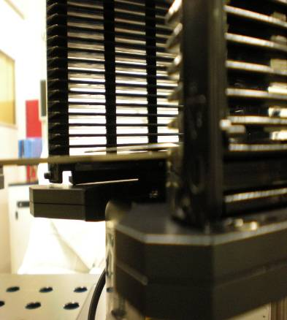
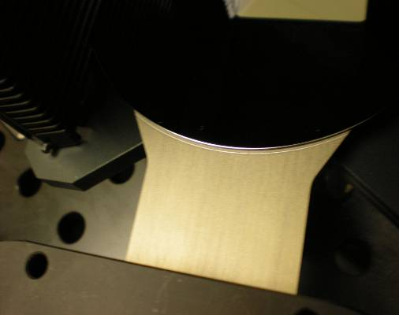
TEACH STAGE POSITION校正:
1.於CASSETTE SLOT1放置一片WAFER,平邊須朝操作人員.
NOTE:校正POSITION只需校正SLOT1即可
2.將ROBOT (T軸AND Z軸轉向STAGE)
COMMAND:MTPS j(STAGEj&J&k&K&m&M都需TEACH POSITION).
3.將SERVO OFF,將ROBOT拉至STAGE SLOT1與平邊切齊
COMMAND:SVOF(SERVO OFF)
NOTE:SLOT1 WAFER晶背需與BLADE微貼
WAFER晶背須與BLADE微貼
WAFER須與BLADE弧線切齊,
SLOT1 WAFER須與BLADE微貼

Slide 21
4.CHECK (T,R,Z)三軸POSITION是否OK
若不OK,則微調(T,R,Z)三軸POSITION
﹛ T軸不OK,則調整T軸參數 COMMAND:MOVR T, ±X
R軸不OK,則調整R軸參數 COMMAND:MOVR R, ±X
Z軸不OK,則調整Z軸參數 COMMAND:MOVR Z, ±X ﹜
5.CHECK (T,R,Z)三軸POSITION OK,則儲存ROBOT現在的座標.
COMMAND:SPC J➔會出現ROBOT現在三軸的POSITION參數
如(T,R,Z)=(XXX,XXX,XXX)
6.將儲存的三軸參數叫出看是否與剛剛所校正的參數相同
COMMAND:RCS J,(XXX,XXX,XXX)
7.若相同則將參數儲存至CPU裡
COMMAND:SAV
8.將Z軸位置降低,避免做HOME時將WAFER拉出
COMMAND:MOVR Z,-X
9.將R軸回到HOME點
COMMAND:RETH
10.試抓WAFER,看WAFER與BLADE間隙是否OK,WAFER EDGE是否在BLADE弧線上
COMMAND:GET j,1
11.若不OK,則再回到STEP.4 重新微調三軸的POSITION,直至OK為止
12.若OK,則將WAFER抓出,放置ALIGNER.
COMMAND:PUT Z,1

Slide 22
13.將ALIGNER DO INITIAL 讓WAFER轉到內部設定的角度
COMMAND:ALIGN
14.重複STEP.10與STEP.12,CHECK BLADE抓放WAFER POSITION是否正常,
15.NOTE:ROBOT BLADE進入CASSETTE抓取WAFER時,WAFER
抬起時,須在CASSETTE PITCH與PITCH之間.
16.如位置不OK,則微調Z軸高度
COMMAND:MOVR Z, ±X

Slide 23
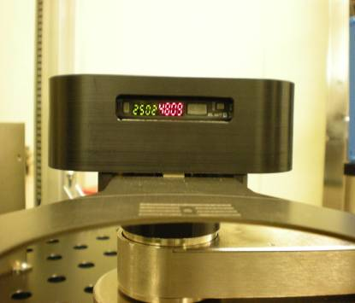
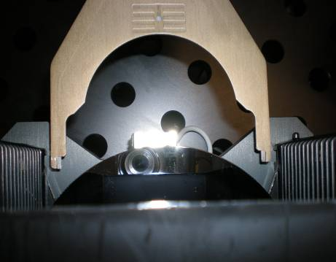
SCAN MAPPING強度校正:
1.CHECK SCAN強度=>需大寫(J,K,M)
2.將ROBOT (T軸AND Z軸轉向STAGE J)
COMMAND:MTPS J
3.將 R軸SERVO OFF
COMMAND:SVOF R
4.將SCAN MAPPING SIGNAL開啟
COMMAND:OUTP 2,1
5.將ROBOT BLADE推至WAFER(與WAFER距離約2CM)
距離約2CM
SCAN開啟時,系統數字會
亮起來

Slide 24
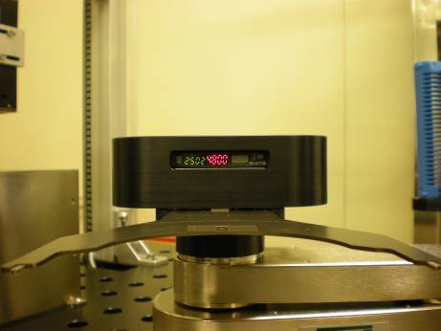
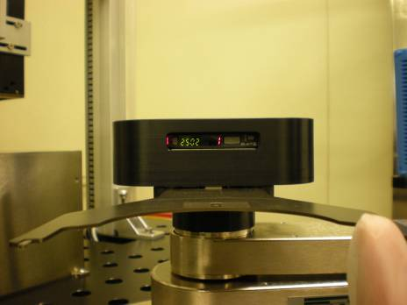
5.CHECK Z軸高度是否可遮斷SENSOR
COMMAND:MOVR Z±X
NOTE:ADJUST至SCAN SENSOR有遮斷到WAFER
調整至可遮斷WAFER
6.調整OK後,需讀出現在ROBOT T,R,Z POSITION.
COMMAND:RCP(CHECK ROBOT現在的POSITION)
7.儲存SCAN MAPPING ROBOT現在的參數
COMMAND:SPSC J,T,R,Z(儲存SCAN MAPPING的參數)
8.叫出SCAN儲存後的參數
COMMAND:RSCS J(SCAN的位置)
SENSOR有遮斷
表示有MAPPING到WAFER
SENSOR無遮斷

Slide 25
9.將DATA儲存至CPU裡
COMMAND:SAV(SAVE至CPU)
10.將R,T,Z三軸的SEVRO ON 起來
COMMAND:SVON
11.將R軸回到HOME點
COMMAND:RETH
12.CHECK SCAN MAPPING是否正確
COMMAND:SCAN J,1
畫面上會SHOW出SOLT1~SLOT25的片數
如:0001112111000001111101011
0:表示無WAFER在SLOT裡面
1:表示有WAFER在SLOT裡面
2:表示WAFER有斜插在SLOT裡面
13.若SCAN MAPPING有異常,可利用COMMAND來調整
MAPPING的正確性
COMMAND:TSCN J,13
畫面會SHOW出 OLDZ:X(表舊的讀值),NEWZ:X(表新的讀值)
TEST到OLDZ=NEWZ即可.
14.若N.G,重複STEP.12 AND STEP.13,TEST到MAPPING正確為止.
15.將參數儲存至CPU裡
COMMAND:SAV(SAVE)

Slide 26
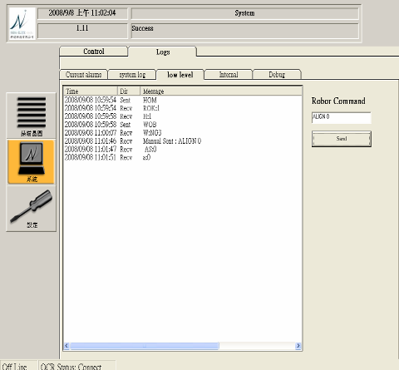
OCR辨識機校正:
1.取一片報廢WAFER有刻號的,放置ALIGNER處
2.至系統裡輸入PASSWARD:a0
3.至LOGS裡面的LOW LEVEL右上角出入COMMAND
COMMAND:ALIGN(讓WAFER轉至HOME點)
4.再下COMMAND:ALIGN 0(OCR辨識刻號的角度)
密碼:a0

Slide 27

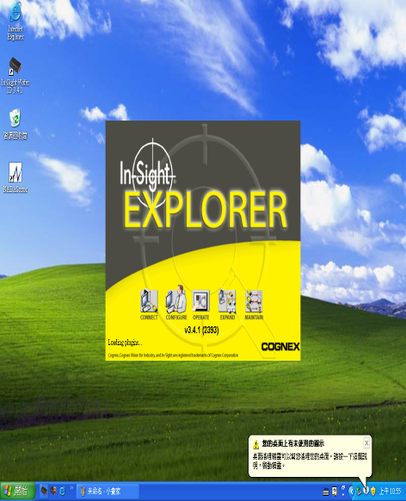
5.將NADASORTER SYSTEM關閉.
6.再致電腦左下角點選IN-SIGHT WAFER ID3.4.1的捷徑
此時電腦會自動開啟OCR辨識系統
IN-SIGHT WAFER ID3.4.1
OCR辨識系統開啟畫面

Slide 28
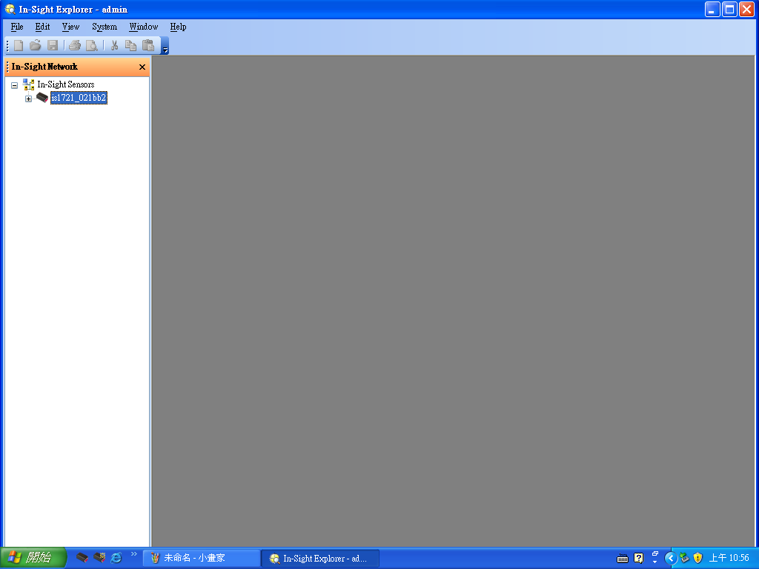
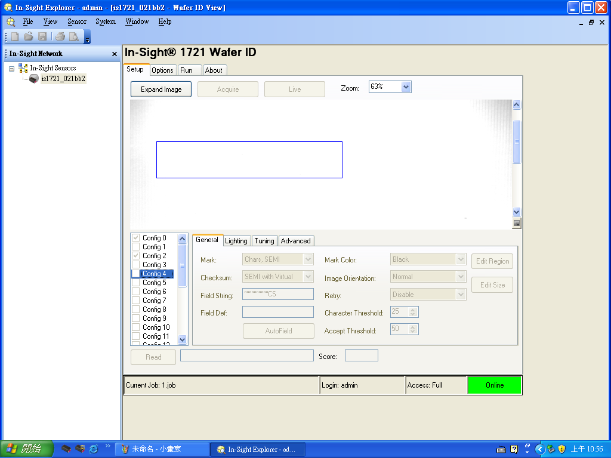
7.點選左上方is1721-021bb2方塊
8.此時OCR辨識校正系統已開啟如右下圖所示.
點選IS1721-021bb2

Slide 29
9.先至SETUP的GENERAL裡面的FIELD STRING,將所要辨識刻號的WAFER
如FAB裡的產品刻號皆為(27-23845-0 04)共13碼, 因-與空格也算一碼
故需在FIELD STRING裡面KEY IN:**-*****-****共13碼

Slide 30
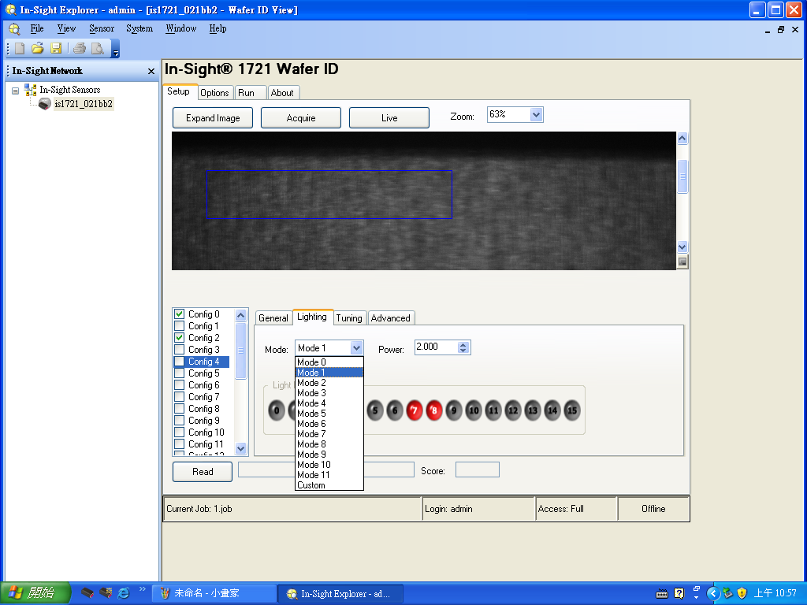
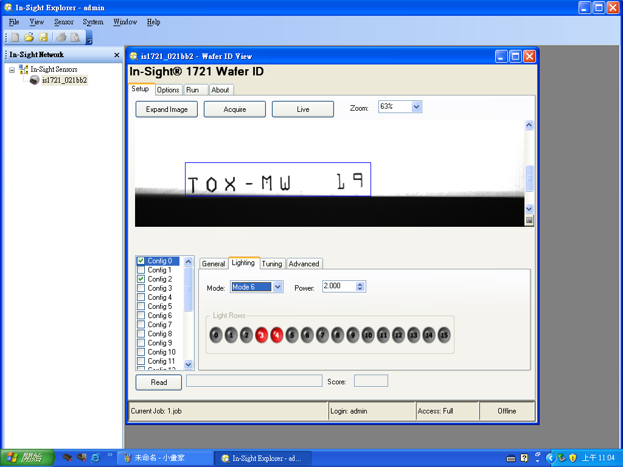
10.選取LIGHTING裡的MODE(燈號)及POWER選取至刻號可明顯看出
如右圖

Slide 31
11.至SETUP裡的GENERAL選取EDIT REGION(OCR所要辨識的範圍)
1
2

Slide 32
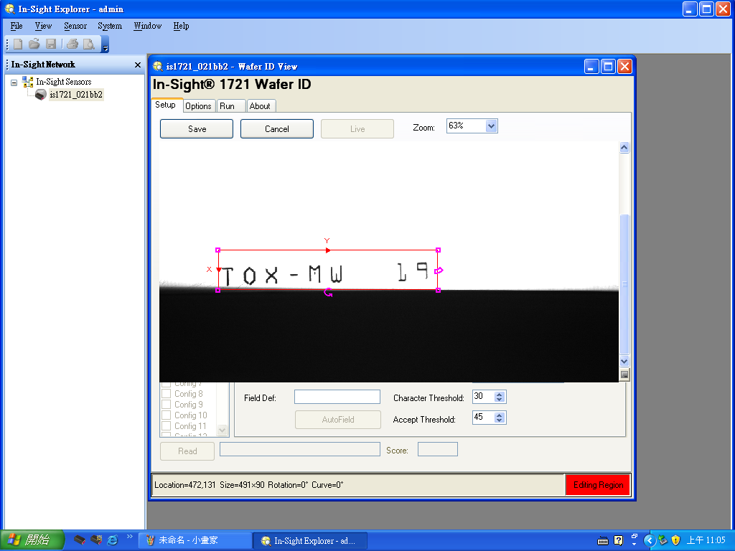
12.將刻號的範圍設定出來後,再按下SAVE.如下圖
2
1

Slide 33
13.至SETUP裡的GENERAL選取EDIT SIZE(OCR所要辨識單一個字的大小)
1
2

Slide 34
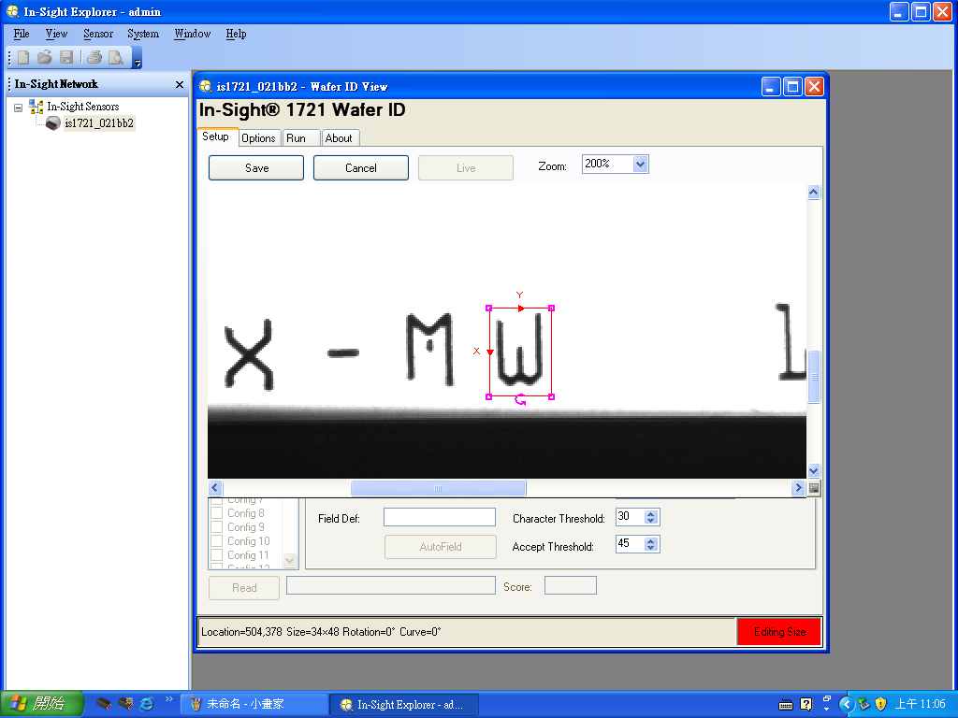
14.將刻號的單一個字的大小設定出來後,再按下SAVE.如下圖
2
1

Slide 35
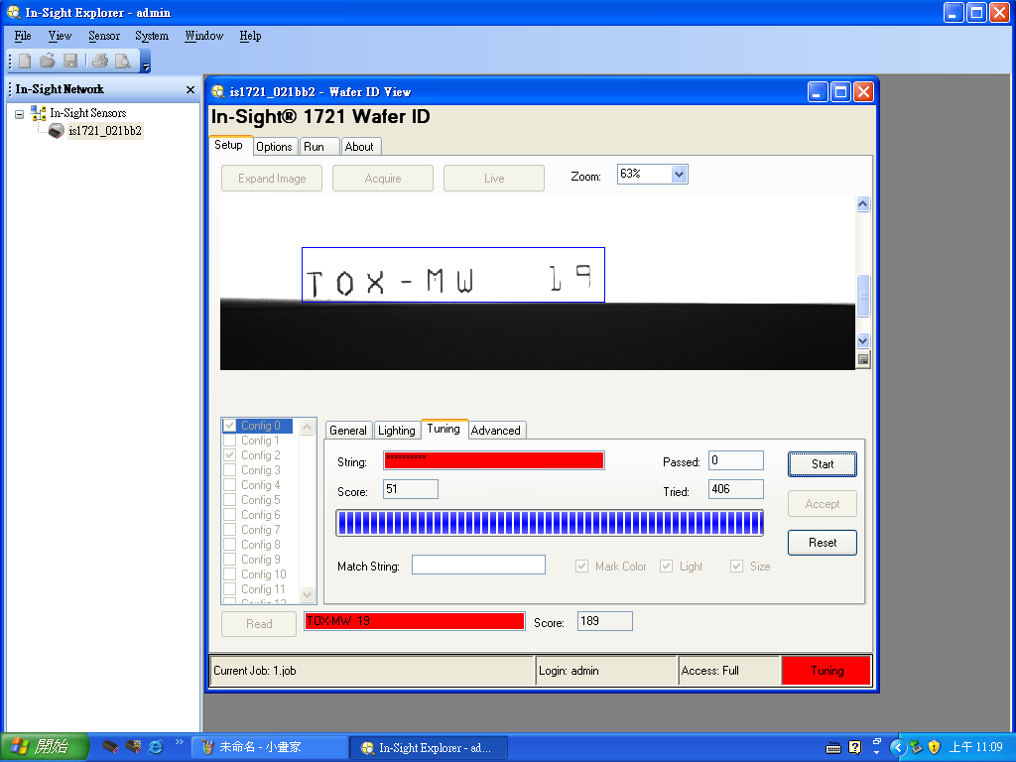
15.至SETUP的TURNING裡面,點取START鍵, 此時OCR會開始辨識刻號.
辨識刻號需與下圖的最下方出現的字相同.
NOTE:若刻號辨識錯誤或辨識不清楚,請重覆STEP.9~STEP.13,直至刻號辨識OK.
上下兩排的字須相同即可

Slide 36
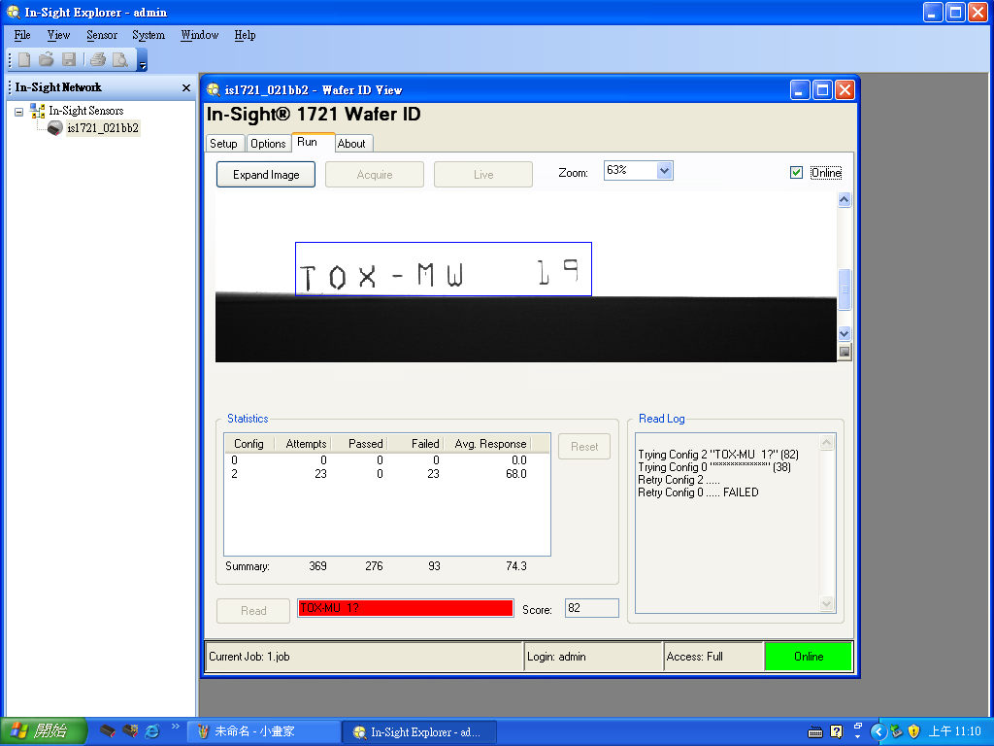
16.至左上角點選FILE裡的SAVE JOB即可完成OCR刻號校正
離開之前須先將ON-LINE打勾之後再離開

